Slide 1
Team GRIPE
Marc Kleefstra
Earle Cottingham
Patrick Barnes

Slide 2
GRIPE
Greenwood Bank Incident Protocol Enforcement

Slide 3
Introducing Team GRIPE
Patrick Barnes
Project Manager
Programmer
User Experience
Marc Kleefstra
Master Programmer
Database Admin
Design
Earle Cottingham
Programmer
Testing
Documentation

Slide 4
What Do We Have a GRIPE Over?
Tech support
Employees lined up at the IT help desk guy’s office
Repeat problems and no organization
Keeping track of technology assets
IT guys have no idea what PC you broke
The suits have no idea who stole what laptop
Where is my stapler?
Currently no existing system with this functionality

Slide 5

A New Way to Handle Things
Greenwell Bank system for tracking technology assets
Ticket system to organize and facilitate tech support

Slide 6
Tell Me More!
GRIPE is a web-based application
Never lose track of who has what PC or printer
What was the serial for Office 2013 again?
Resolve tech support problems with minimal fuss
Stay up to date on why that floppy disk won’t fit into your CD drive!
Precision control for Business managers

Slide 7
The Basics
Ticket tracking system
IT guys have a GRIPE with your tickets
Feedback on ticket progress
Keep track of ALL the things!
Who has what
What department has what

Slide 8
Main Application Functions
Login Screen
List Tickets
Accept/Take Tickets
Update Tickets

Slide 9
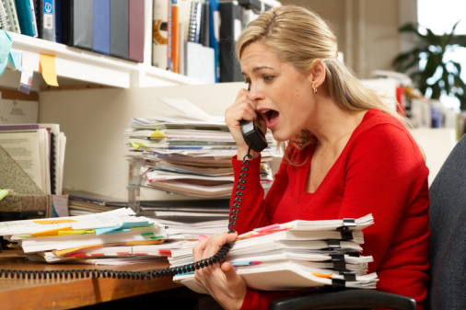
Personas: General Employee
Needs:
Log in and create tickets
View his or her own tickets and their progress
See detailed information about their technology assets

Slide 10
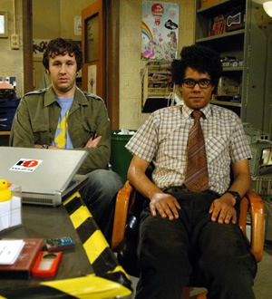
Personas: The IT help desk
Needs:
See all available tickets
Assign tickets to themselves
See what equipment belongs to ticket creator
Add comments and updates to tickets
Close or release tickets back into the pool

Slide 11
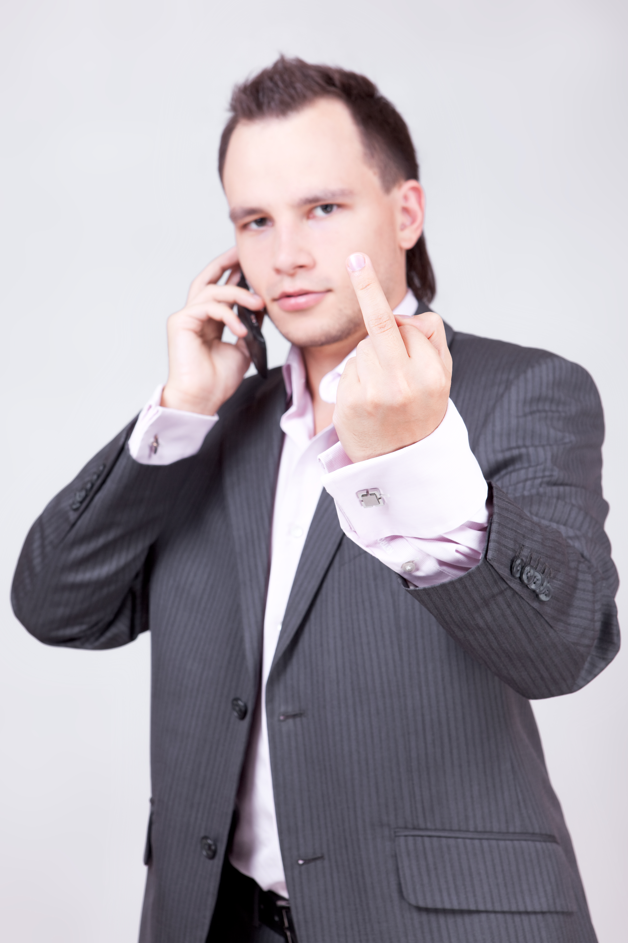
Personas: The nosey executive
Needs:
Read-only access to all tickets.
Track ownership of technology assets.

Slide 12
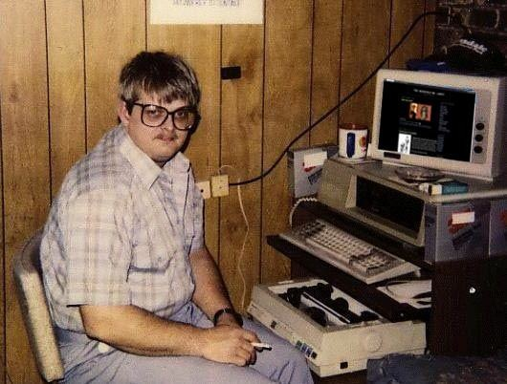
Personas: System Admin
Needs:
Remove tickets from system
Update, remove, add assets to users
Keep track of error logs with GRIPE
Everything

Slide 13
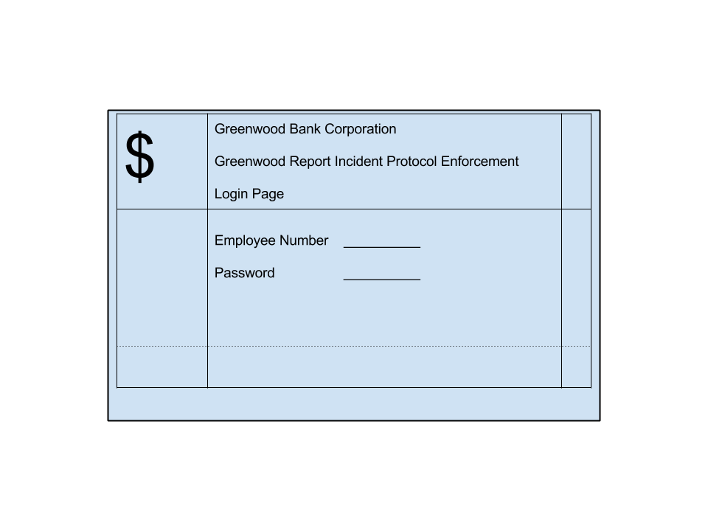
What Else?
Security
Login access on-site only
Error handling
No need to spam errors to end users
Log it all for the system admin

Slide 14
Use Case Scenario
Timid Tom, staff support, can’t read documents from elsewhere in the office
Tom logs into GRIPE and submits a ticket
Help Desk Harvey sees the ticket and takes it
As Harvey works on the ticket, he leaves update notes
Harvey assigns Tom a new PC to fix the problem
Harvey closes the ticket
Sly Admin Slim makes a note to update Tom’s asset listing to show the new PC

